Slide 1
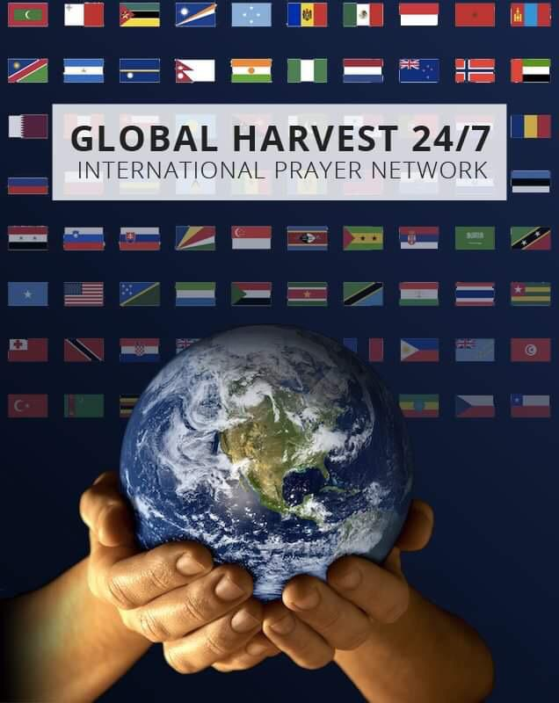
POWER OF INTERCESSION
RAISING A NET OF 24/7 PRAYER OVER THE LAND, A STRATEGY THAT LAYS FOUNDATIONS FOR TRANSFORMING PRAYER OVER NATIONS –COMPILED BY MICHELLE COETZEE

Slide 2
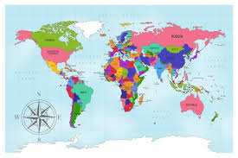
THE VISION: MAPPING TERRITORY FOR SPIRITUAL RESPONSIBILITY: RAISING A NET OF DAY AND NIGHT PRAYER in the nations

Slide 3
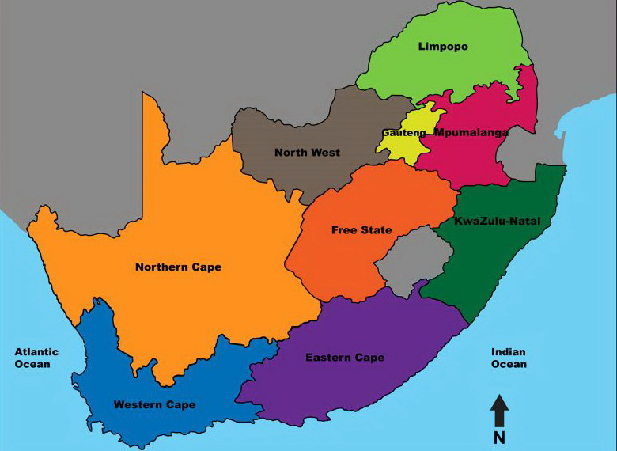
THE VISION: MAPPING TERRITORY FOR SPIRITUAL RESPONSIBILITY: RAISING A NET OF DAY AND NIGHT PRAYER in every municipal area in South Africa

Slide 4
MOBILIZING PRAYER IS THE VERY FIRST PART OF OUR CALL TO SERVICE
1Timothy 2:1 The first thing I want you to do is pray. Pray every way you know how, for everyone you know.
1Ti 2:2 Pray especially for Rulers and their Governments to rule well so we can be quietly about our Business of living simply, in humble contemplation.

Slide 5
The Role of the Gatekeeper in the Prayer Room
What is a Gatekeeper: According to the Old Testament a Gatekeepers was a Levite. Gatekeepers were also Watchmen on the Walls. They were ministering priests from the tribe of Levi.
Gatekeepers made sure that nothing unholy entered into God’s house and nothing was allowed to leave unless it had approval. They were in charge of the Temple items and treasuries of the House of the Lord.
Gatekeepers were trusted officials and high priests in the servant role of protecting the Lord’s house.

Slide 6
Who is a Gatekeeper
Gatekeepers were stationed at all 4 Gates [N,S,E,W]
They also appointed and taught others around them to guard the gate as well.
Their hearts were fully committed to the Lords will.
Today’s gatekeepers hope and pray for Revival and eagerly await the Lord’s return. They are always prepared and continually remind others to be ready.

Slide 7
The Role of an Intercessor
An Intercessor basically communicates with God on behalf of others
There are many even in the body of Christ who might struggle with what to say, how to say it or when to say it to an all-knowing God
The Intercessor’s primary role is to communicate and verbalize these specific needs to God with the expectation that God will answer and provide His solution in His timing to each and every prayer that is presented to Him.

Slide 8
The Responsibility of the Intercessor
An Intercessor may participate in a designated time slot for prayer
THE HEART OF THE INTERCESSOR
An unselfish and forgiving heart is necessary to be an effective Intercessor.
The Intercessor has a strong desire or heavy burden to see people delivered, saved, released, healed and set free but understands that it is by no power of their own that their prayers are answered. [Matthew 28:18]

Slide 9
Characteristics of an Intercessor
Discernment
Compassion
Integrity
Forgiving Heart
A heart for people
Humility
Desire to please God

Slide 10
You need to carry the weight of His Presence, His Shekinah Glory
First things first: Before we can mobilize others to pray, we need to move in a flow of deep intimacy with the Lord Jesus Christ.
Our walk with the Lord: Purity and Holiness
A life of total surrender: The key is the Living Creatures, must become the Living Sacrifices-Romans 12:1-2, and Revelation 4.
Mutual Abiding: The mingling of God and Man, I am in Christ Jesus, Christ in me the hope of glory-John 15 [Vine-Connected to Christ] Promise: Rivers of Living Waters will flow

Slide 11
Your Family Altar [Home Base]
First things first, Get your house in order: “Raising the Family Altar”, first Corporate Altar and Church-Mth 18:19-20 Two agree…
Making your home a Habitation for God is the first step to Community Transformation.
Your first altar must be the Marriage altar.
Your children are tomorrow’s Church.
Parents hold greatest influence over their children.
Corporate altars give greater legal authority.

Slide 12
The Power of the Family Altar
Corporate Prayer gives opportunity for God to give strategy-Prayer sustained the early Church in Acts of the Apostles, Acts 2:42-47, everyday these people came together and prayed, breaking bread-house to house. As they did that, God added to them those who got saved.
Corporate Altars, initiate Transformation:
Corporate Altars, penetrate where Pastors cannot, Jeremiah 9:20-21, ‘Call out the wailing women who were to teach their children, to wail and stay the destruction and judgment coming through the land” Teach your children how to abide in the
presence, experience the sweet aroma.

Slide 13
Recruiting Prayer Warriors: POLE
Planning:
Organising
Leading
Evaluation
Two strategies to help establish
Prayer Warriors:
Strategy-1: Appoint a Prayer Correspondent
Strategy-2: Appoint a Prayer Coordinator
Set up a War Room

Slide 14
STRATEGY-I): APPOINT A PRAYER CORRESPONDENT
News of answers to prayer fans the flames of prayer.
The better the reporting, the stronger the blaze.
Prayer correspondents are a much needed kind of communicator.
They retrieve, sift and report answers to prayer.
The work takes time, labor and modest amounts of money.
However, it is this kind of investment that God uses to walk a movement through to completion [Ephesians 1:15-19].
Ernie Pyle was a World War 2 hero.
He carried no gun; stormed no hill.
As a war correspondent, Pyle represented a courageous group of corps people who helped keep a nation united in a critical cause.
He roved battlefronts, often under fire, and did a terrific job.
He was killed in action.
The great commission of Jesus Christ can be advanced immeasurably by people who fill a similar role in God’s spiritual war.
Call them prayer correspondents.
Their task is to unite the body of Christ in spiritual warfare.

Slide 15
Purpose: To provide information to Intercessors and to enlist and train others for the same kind of service.
Qualifications:
(Facilitates and disciples Intercessors)
i] A commitment to fulfillment of the great commission in
Christ.
ii] An awareness of the spiritual conflict involved in world
Evangelization.
iii] A hope filled attitude that can both inspire and challenge
Christian workers.
iv] A desire to nurture great commission prayer.
v] The ability to follow an organization’s communication
policies in prioritized, accurate, and concise manner.

Slide 16
Responsibilities:
i] Communicate a flow of great commission information between Mission Fields and Intercessors.
ii] Develop a model personal prayer ministry.
iii] Recruit and train other correspondents on domestic and foreign mission fields.
iv] Provide a communications center to assist with and develop a visualization of global prayer.

Slide 17
Recruiting procedures:
Ministry leaders who want to acquire a prayer correspondent may find the following preparation steps helpful.
Success in recruiting and retaining such persons is dependant on the correspondent’s access to objectives, plans, structure, and progress of the organizational body.
i] Acquaint the correspondent with your vision [Mathew
9:36-38]
ii] Expose him or her to priority issues and objectives [John
15:15, 16]
iii] Help him or her to enlist other strategic correspondents
[1 Peter 2:9]
iv] Provide operational facilities [note availability of facilities
in Luke 2:36-38]

Slide 18
STRATEGY-II):
THE MOST IMPORTANT ACTION IS TO APPOINT A PRAYER COORDINATOR THAT WILL MOBILISE PRAYER, AND INTERCESSORS AND SUSTAIN CONTINUOUS PRAYER IN THE CHURCH.
PRAYER COORDINATOR
JOB DESCRIPTION
PURPOSE:
To develop a prayer-leadership team for the great Commission objectives of the Church
QUALIFICATIONS:
A steadfast, growing prayer life
Ability to lead leaders
Agreement with doctrinal position and administrative policies of the church
Commitment to revival and fulfillment of the Great Commission of Jesus Christ

Slide 19
RESPONSIBILITIES:
Model, encourage, and nurture
various forms of prayer
Serve as a channel of communication between church staff and congregational Intercessory groups.
Stimulate, assist, and coordinate Prayer activities
DUTIES:
Intercede.
See that a prayer leader is elected or appointed for each division of the Body.
Meet with prayer leaders periodically to encourage, evaluate, and refine the prayer ministry.
Promote the Great Commission Prayer goals of the body.
Train a growing team of prayer leaders.
Plan prayer studies, workshops, classes, seminars, and conferences for recommendation to decision-makers.
Establish and maintain a spiritual war room to monitor progress.
Help leaders in each division to use prayer agendas.
Assist church staff in planning an annual prayer conference.
Confer with church staff and prayer leaders concerning the big prayer

Slide 20
PLANNING
Enlist new Prayer Warriors
Look at: “How can we develop sustainable prayer in the Church?
i). Sustain your Personal altar of prayer
ii).Sustain your family altar of prayer- every
night
iii). Sustain your Church altar of prayer-
[Choose a suitable day]
Iv). Sustain your Community altar of prayer, meeting with other churches to pray in Unity, in one accord, this could happen once a week

Slide 21
His action plan is also a prayer plan for the harvest.
John 15:16 "You didn't choose me, remember; I chose you, and put you in the world to bear fruit, fruit that won't spoil. As fruit bearers, whatever you ask the Father in relation to me, he gives you.
Christ has chosen us as leaders, as Intercessors
and as the Church, he is giving us a strategy:
To go and bring forth permanent fruit
Ask the father for that fruit
You need to begin by planning for the harvest in your
planning.
If you expect a harvest of souls, you need to start with
prayer.
Prayer fertilizers the soil for a great harvest!
Prayers are a prime driving force in world Evangelization.

Slide 22
Set Prayer Targets for your Neighbourhood, or the area that you wish to reach.
Prayer targets Group responsible Prayer
--------------- -------------------
--------------- -------------------
--------------- -------------------
--------------- -------------------

Slide 23
Organising
When Christ ascended to heaven all he left on earth was a prayer meeting-(Acts 1-2).
The Gospel entered Europe through Lydia’s Prayer band
(Acts 16).
Paul started Churches as prayer cells (2 Corinthians 1:11, Ephesians 6:18, Phillippians 4:6-7, Colossians 4:2-3)
Praying house churches are dynamically spreading the gospel today in countries with limited access to Christianity, according to national Christian leaders.

Slide 24
The Discipleship training school for the Intercessors information is available on the website

Slide 25
Discipleship of Prayer Warriors
Get closer to God.
Get others to know God.
Get out of the way.
The key is the living creatures must become the living sacrifices.
Romans 12:1-2
Revelation 4

Slide 26
Unite with others
As you come into this Priesthood, blow the trumpet and share the Vision.
Alone, you cannot do it.
If you try that, within a few months or years, you will slowly die away.
Share the message with others who want to pray.

Slide 27
Have Unity for a purpose
Have unity for a purpose, and join up with people with a burden for their Nation.
You don’t have to be big or powerful in the eyes of men, but you are always big and powerful in the eyes of God, when you walk in his purposes and his ways.

Slide 28
Praying with understanding
We need to pray informed prayers.
That is knowing what to pray for.
We need to pray united prayers.
Unity is needed to pray for revival because with unity we have corporate anointing.
Another prayer that brings revival is persistent prayer. Praying until something happens.

Slide 29
We need to pray informed prayers

Slide 30
Mobilizing Nations to Pray
Gate Keeper | Name | Telephone | Email
Zone 1 : Africa; Eastern Africa, Central Africa, Northern Africa, Western Africa
Zone 2 : Asia; Central Asia, Eastern Asia, Southern Asia, South Eastern Asia, Western Asia
Zone 3 : Europe; Eastern Europe, Northern Europe, Southern Europe, Western Europe

Slide 31
Gate Keeper | Name | Telephone | Email
Zone 4 : Middle East; Region 1 & 2
Zone 5 : North America; Region 1,2 & 3
Zone 6 : Central America and the Caribbean; Central America & The Caribbean

Slide 32
Gate Keeper | Name | Telephone | Email
Zone 7 : South America; Region 1 & 2
Zone 8 : The Pacific; Region 1,2,3 & 4
Zone 9 : The Arctic ; The North Pole
Zone 10 : Antarctica ; The South Pole

Slide 33
Night Watches
Praying for the Eight Gates of Society | Names of Gate Keepers | Tel | Email
1st Watch 18:00-21:00 Family Gate:
2nd Watch 21:00-24:00 Belief System Gate:
3rd Watch 24:00-03:00 Government, Governance and Leadership Gate:
4th Watch 03:00-06:00 Economy Gate:
Notes:
STARTING OF THE GATES {THROUGH PRAYER}

Slide 34
Day Watches
Praying for the Eight Gates of Society | Names of Gate Keepers | Tel | Email
1st Watch 06:00-09:00 Education Gate:
2nd Watch 09:00-12:00 Science and Technology Gate:
3rd Watch 12:00-15:00 Media Gate:
4th Watch 15:00-18:00 Arts, Sports and Culture Gate:

Slide 35
The Timing of God
When God is calling a Nation, there is a time of calling and the time for visitation.
God is saying I have a calling over your Nation, but before I can visit, you need to prepare the land.
Elijah brought revival in the land. First it happened in the Spirit and now it started to show in the physical.
Fire came down showing there is open heaven.

Slide 36
Prepare before you pray
If we sleep as a Church, the other Priests of the devil, somehow, somewhere, sacrifice every month or every season, or in the year to that spirit.
You find that the name of areas takes the name of the spirit ruling that area.

Slide 37
Repair God’s broken Altar
First Baal’s people prepared sacrifice.
The Bible does not say they erected an altar.
It means they were always giving sacrifice and tending their altar so it was in good order.
They put their sacrifice and cried to Baal until evening.
The Bible says in v30 Then Elijah said to the people, come near to me. So all the People came near to him. And he repaired the altar of the Lord that was broken down.

Slide 38
This shows that the people were no longer giving sacrifices to the living God.
That is why the altar of God was in ruins.
Elijah knew, before the presence of God can come in the land, before he can contend with the power ruling the land, before he can give a sacrifice pleasing to God, he needed first to repair the altar of God. God is calling us to set up prayer altars and to repair the ones that are in ruins. Let us start with our hearts, families and move on from there, repairing the broken down altar of God in our lives.

Slide 39
Spiritual Mapping
Targetted attack
When you read the history of the place, you find there is a connection with the spirit over that place so go back and find out how does it come about? What keeps it ruling in that area?
A spirit cannot rule over a place unless it has a covenant with the people of that place. That is why we find that when we come to pray before we say “Go!” we must repent and seek how to remove the covenant.

Slide 40
OUR COMMON PURPOSE
To see Revival come to the Nations
To see His Kingdom come, His will be done on earth as it is in Heaven.
To unite in prayer, by sharing the Vision of Christ, with those who have a Kingdom Vision
Recognizing, we cannot do it alone, each one comes with a peculiar anointing.
We need the body of Christ, each one has a piece of the puzzle.
Instituting a network of united prayer all over the Nations.

Slide 41
Steps to get you started in the Global 24/7 Prayer Initiative
1] Register to be part of the global 24/7 prayer initiative
This can be done on our website or by email.
2] Listen to the Table Mountain call for repentance
3]Organize a day of fasting, Prayer and repentance with your Intercessors.
This can be done on whatsapp or zoom.
4] Organize a prayer meeting, waiting , watching and hearing what the Holy spirit is saying to you as a corporate group regarding the prayer action that must be taken.
5] Start praying in your locality as soon as you commit to join the Global Wave of Prayer.

Slide 42
How to activate and start a 24/7 prayer group
It is an easy and enjoyable and uncomplicated process. You only need 24 people in your Church or Organization; however it is a very good idea to mobilize 48 people 2 people per hour to have double covered day and night continuous prayer. Each one praying the Word of God out loud in the same one hour every day of the week.

Slide 43
Share the vision of 24/7 Joyful day and night praying the Word out loud as a wall of prayer pattern.
Ask Intercessors for their commitment for an hour of praying God’s Word out loud every day that will bless and transform those who do it tremendously, as they too will now receive 24/7 praying the word continually from the other 24/7 praying the Word Bibliathon prayer groups.
Just start even if you only have one or two or four hours at the wall covered.

Slide 44
Continue to share the vision until all 24-hours praying the Word aloud slots are completed.
Write their names and cell phone numbers into the prayer schedule
Find prayer roster below

Slide 45
24/7 Prayer roster
NIGHT WATCHES |  | NAME | CONTACT NUMBER | NAME | CONTACT NUMBER
FAMILY | 18H­19H
FAMILY | 19H-20H
FAMILY | 20H-21H
BELIEFSYSTEM | 21H-22H
BELIEFSYSTEM | 22H-23H
BELIEFSYSTEM | 23H-24H
GOVERNMENT | 00H-01H
GOVERNMENT | 01H-02H
GOVERNMENT | 02H-03H
ECONOMY | 03H-04H
ECONOMY | 04H-05H
ECONOMY | 05H-06H
DAY WATCHES |  | NAME | CONTACT NUMBER | NAME | CONTACT NUMBER
EDUCATION | 06H-07H
EDUCATION | 07H-08H
EDUCATION | 08H-09H
SCIENCE & TECH | 09H-10H
SCIENCE & TECH | 10H-11H
SCIENCE & TECH | 11H-12H
MEDIA | 12H-13H
MEDIA | 13H-14H
MEDIA | 14H-15H
SPORT,ART&CULTU | 15H-16H
SPORT,ART&CULTU | 16H-17H
SPORT,ART&CULTU | 17H-18H

Slide 48
Communication
Coordinate and mobilize Intercessors to pray by email or telephone to update and continually manage the prayer wall.
Maintenance in the form of organizing weekly prayer gatherings with Intercessors to remain strong and committed and share the fruit [testimonies] of praying the word of God out loud daily.
Email – Since all the initial enquiries will come through email, we will communicate with Intercessors on email first after you have registered on the website

Slide 49
Whatsapp – All Prayer Coordinators must start a whatsapp group and serve as the group admins on the group and give directions and guidelines. Prayer events will also be launched on this platform and prayer groups checking in for prayer will report on their whatsapp group.
Zoom – Prayer coordinators must organize their own zoom meetings by providing their groups with a meeting ID or link which will be advertised through our whatsapp groups and we will launch online prayer meetings and conferences connecting each locality together using this platform.

